Slide 1

Technical
Presented by: John Bellamy

Slide 2
Resources
Snowflake inference service container. See notes in github repo: johnb340/xgboost-wine-snowflake:v1
Github: https://github.com/johnlbellamy/snowpark_ml/tree/master

Slide 3

Agenda
Part I Data Engineering:
Diagram
Tables
Solution Overview
Part II E2E ML On Snowflake:
Overview
Data Engineering
Exploratory Analysis & Feature Selection
Transformation/Model Pipeline & Model Repo
Inference Endpoint
Conclusion
QA
Backups

Slide 4
Part I

Slide 5
Solution Overview
What methods or frameworks would you use to orchestrate and schedule this process and what would the execution frequency be? For Spotify and YouTube, if we can use webhooks we can download new data as it is created. Alternatively, some mechanism would have to check that there is data available at some frequency not to exceed 2 minutes.
Diagram the overall architectural diagram of your data pipeline and data storage system (ie incoming data sources, acquisition methods, aggregations, transformations and validations, and outputs) Two fact tables are created to support visualization and aggregation across playlists and plays.
Diagram your proposed data models that will be used by the software engineers to build the visualization layer of this system (to accommodate the given use cases). Based on this use case we can use webhooks and event services like Kafka, Azure Event Hub or even tools native to Snowflake or Databricks. The stage tables load data from all three providers when events occur. The streams then associate IDs/ get ids from the dimension tables. Then this data is pushed to streaming/live tables and CDC matriculates changes into dimension and fact tables. What would your preferred development tools, languages, and frameworks would you use to accommodate this problem? The main tools I would select for this would be a data platform like Databricks or Snowflake, Python and sdks for either platform. An SQL dialect for tables/database creation and data loading. An even service from one of the cloud providers. Then any supported dashboard technology can be used, such as Tableau, PowerBI or SnowSight.
What specific transformations and validations do you anticipate needing to run on the acquired data? It could be that artist names are not always going to be the same. For example, Prince and the artist formerly known as Prince. It could be tricky to reconcile these names. We could transform these names to be general. To test the pipeline flow and validate data, we could randomly query the new data and make sure the values fit within a specific range. We could also have a query we run and we know what the results should be ahead of time so we can also test against that.
How would you test your solution? What aspects would be the hardest to test and why? Which aspects are the most important to test and why? Because we don’t control this data, we won’t be able to verify the quality or whether the values are true or not. Problems with the data model could be hard to identify.
How would you make sure that the system has an extremely high availability (ie 99.99% uptime)? What specific alerting and monitoring would be needed?
How would you accommodate being able to re-run or replay scenarios? In what circumstances would this be useful or necessary?
How would you build in the ability to troubleshoot and debug this system? How could you make sure of speedy identification of issues and/or problematic data sources?
How would you document this entire system for other members of your data engineering and software engineering teams to maintain in your absence? What specific aspects are most important and how would you ensure it was understood?
What resources and people would you want to involve and when? How would you approach this? (ie what would be the plan for the different groups - meetings, stop by desks, Slack/IM/email)?

Slide 6
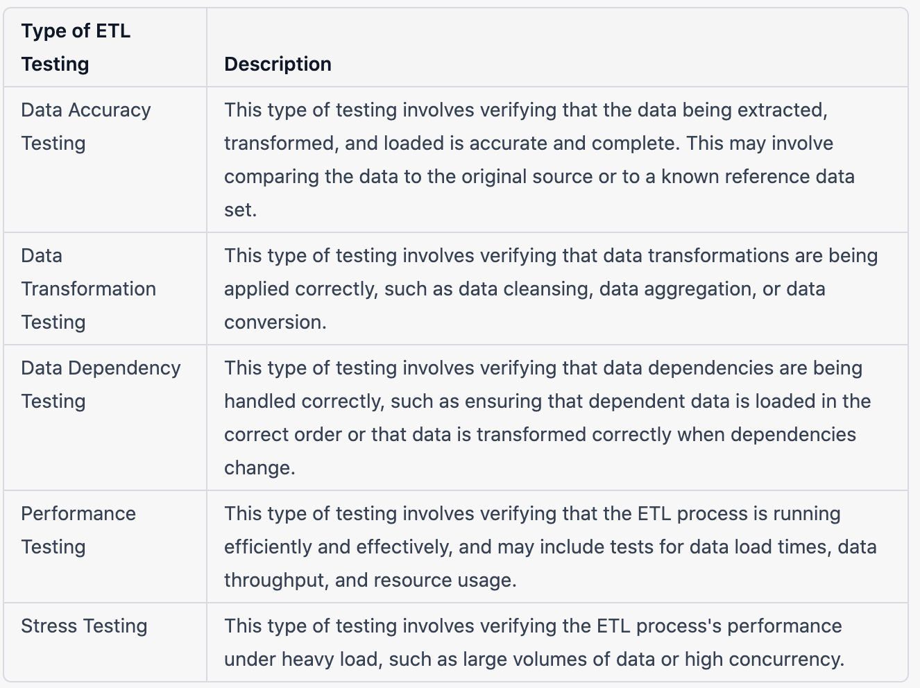
Solution Overview: Testing
Source: LinkedIn Learning and Anshul Thareja

Slide 7
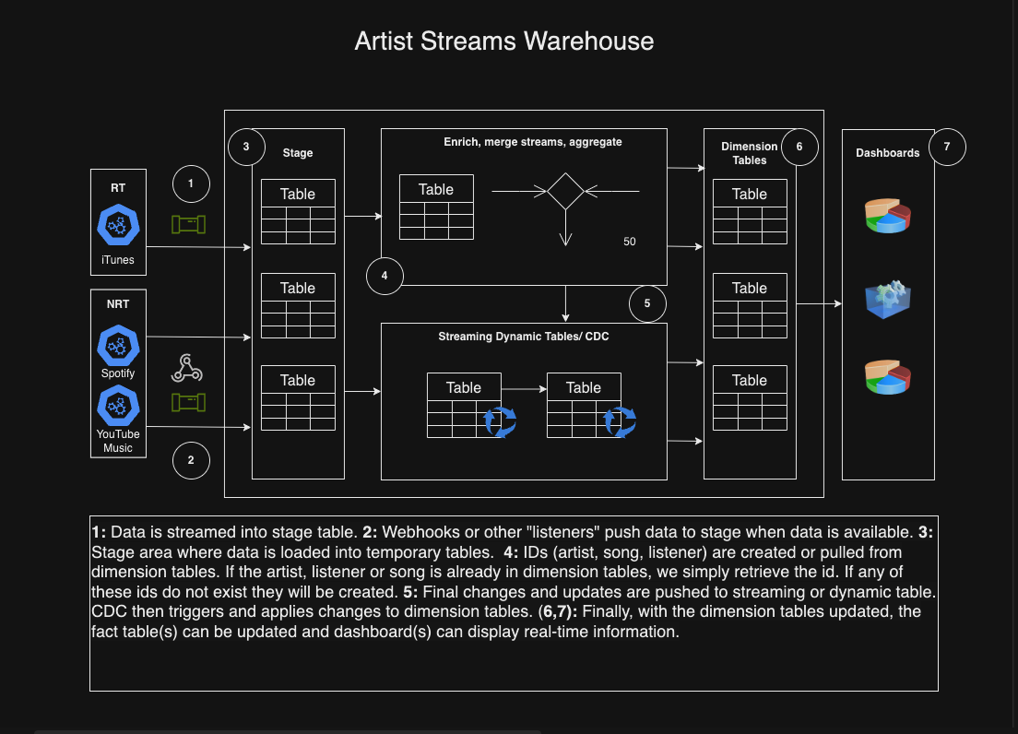
Architecture

Slide 8
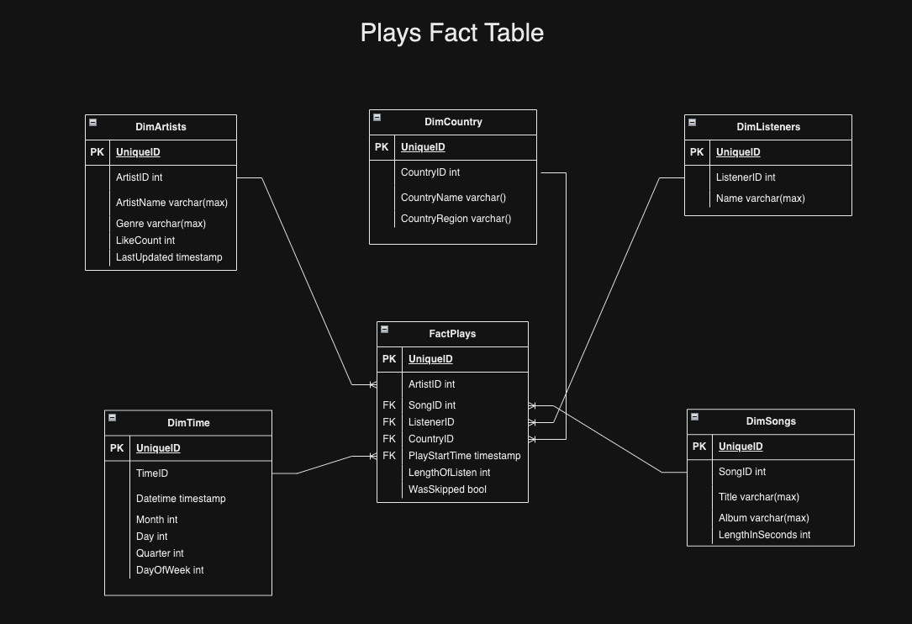
Tables

Slide 9
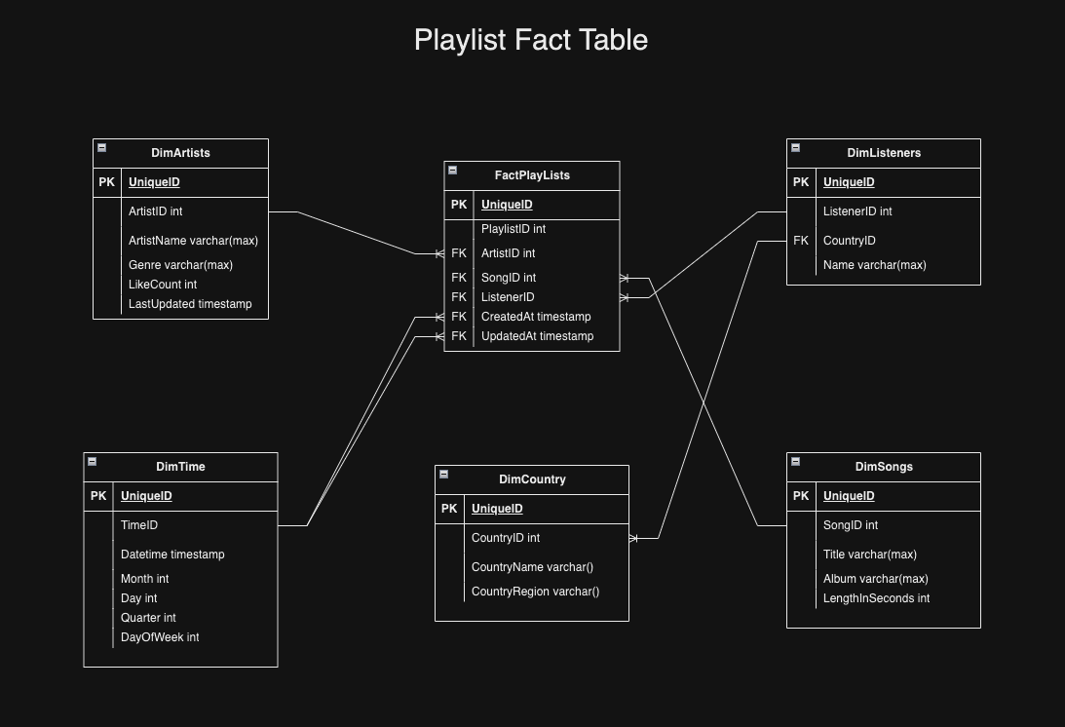
Tables

Slide 10
Part II

Slide 11

Overview
About the data. From UC Irving: “These data are the results of a chemical analysis of wines grown in the same region in Italy but derived from three different cultivars. The analysis determined the quantities of 13 constituents found in each of the three types of wines. ”
The dataset consists of one set for red and white data and is good for classification.
Included in my Github repo is the code that shows the combining of the two datasets, table creation in Snowflake and uploading combined data into Snowflake.
Exploratory analysis and feature selection is then performed.
The chosen features are then modeled and pushed to registry in Snowflake and an inference service serves this model in a Docker container.

Slide 12
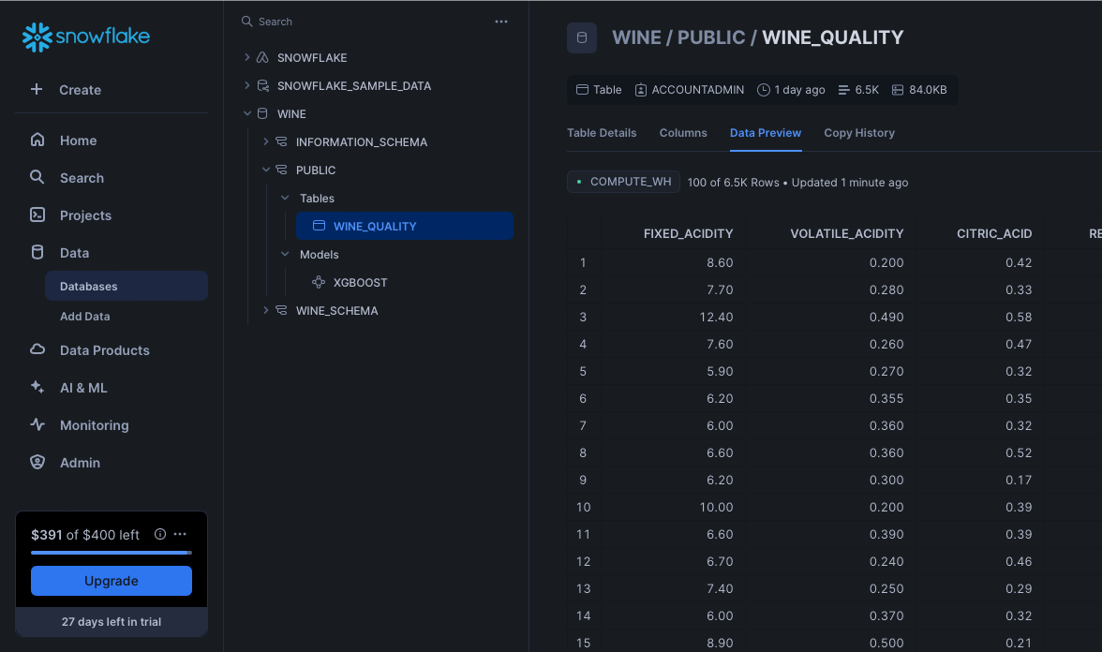
Data Engineering

Slide 13
Exploratory Analysis

Slide 14
Feature Selection

Slide 15
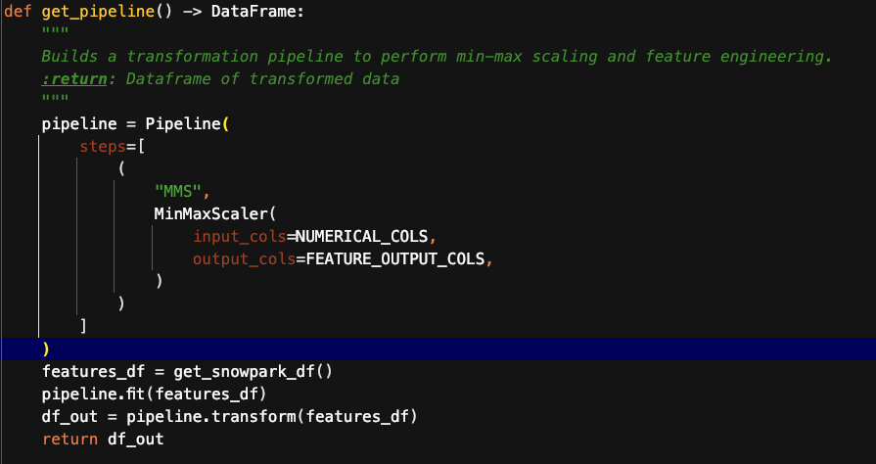
Feat. Eng. Pipeline

Slide 16
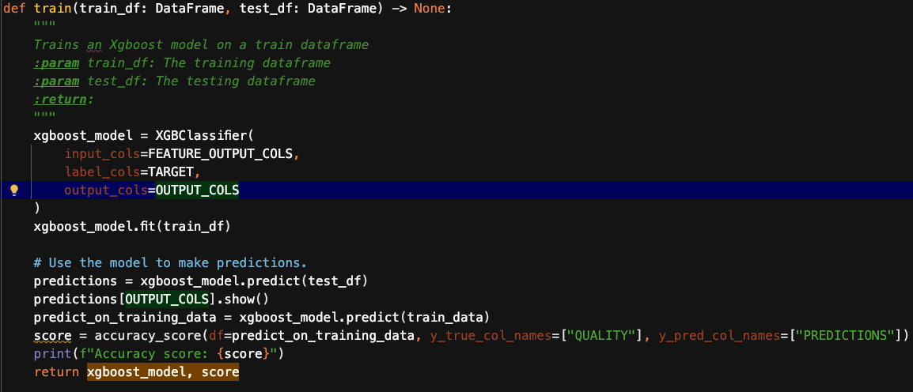
Model Pipeline

Slide 17
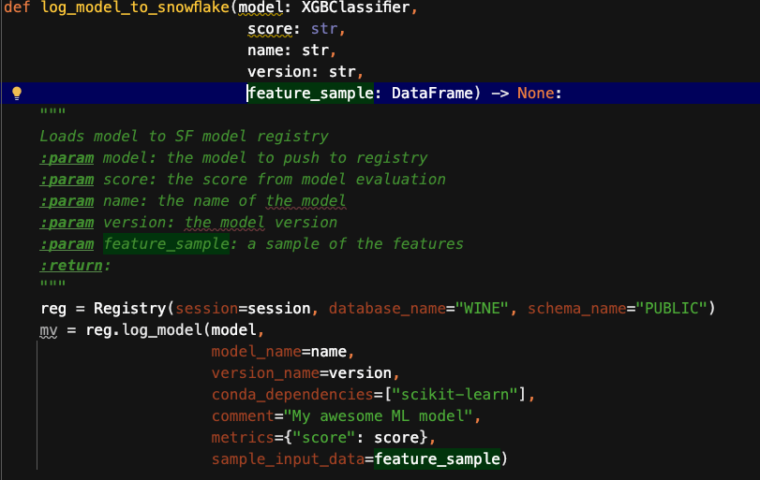
Model Repo

Slide 18
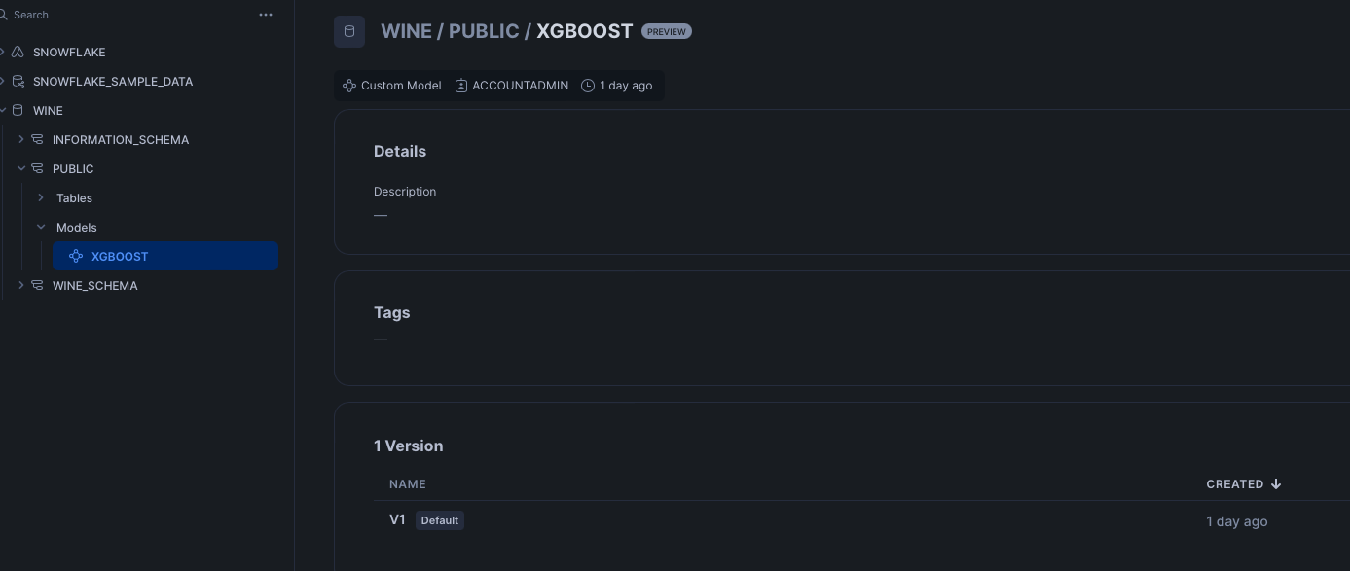
Model Repo

Slide 19
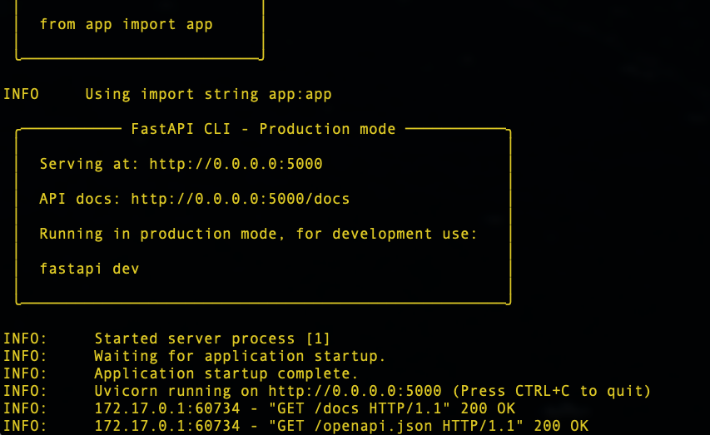
Inference Service

Slide 20
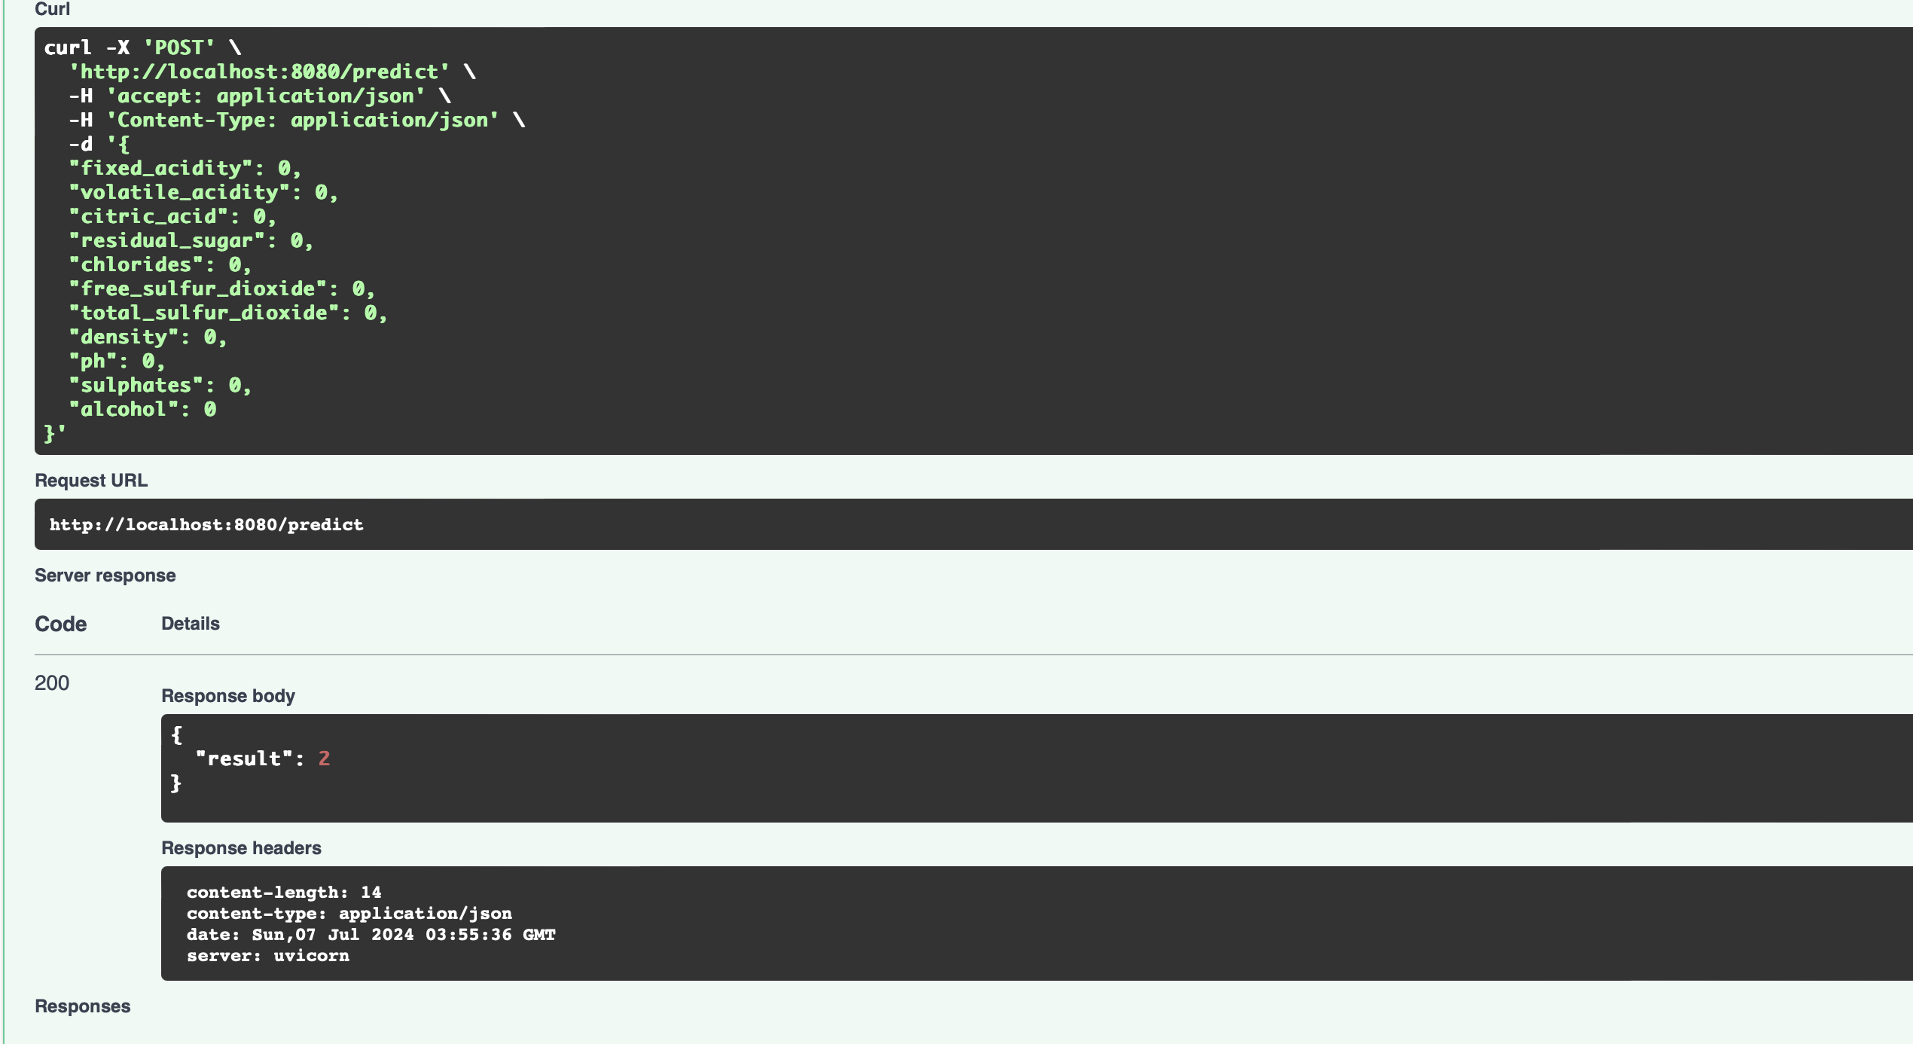
Inference Service

Slide 21
Additional Information

Slide 22
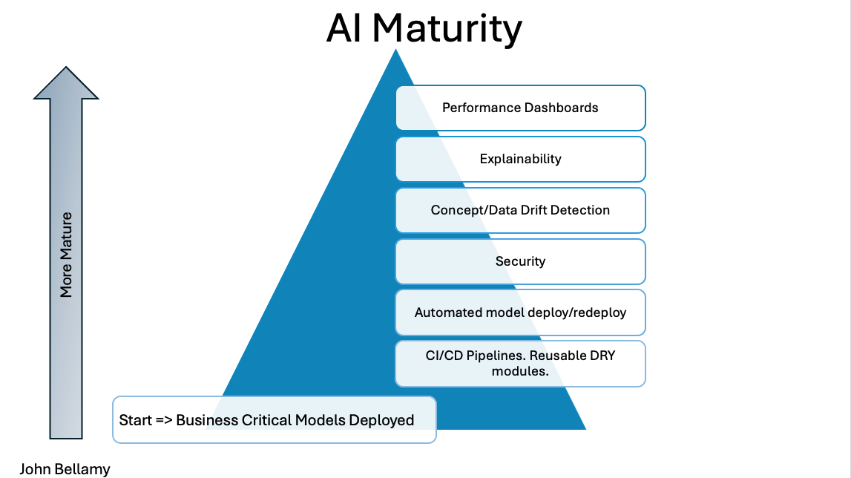
AI MATURITY

Slide 23
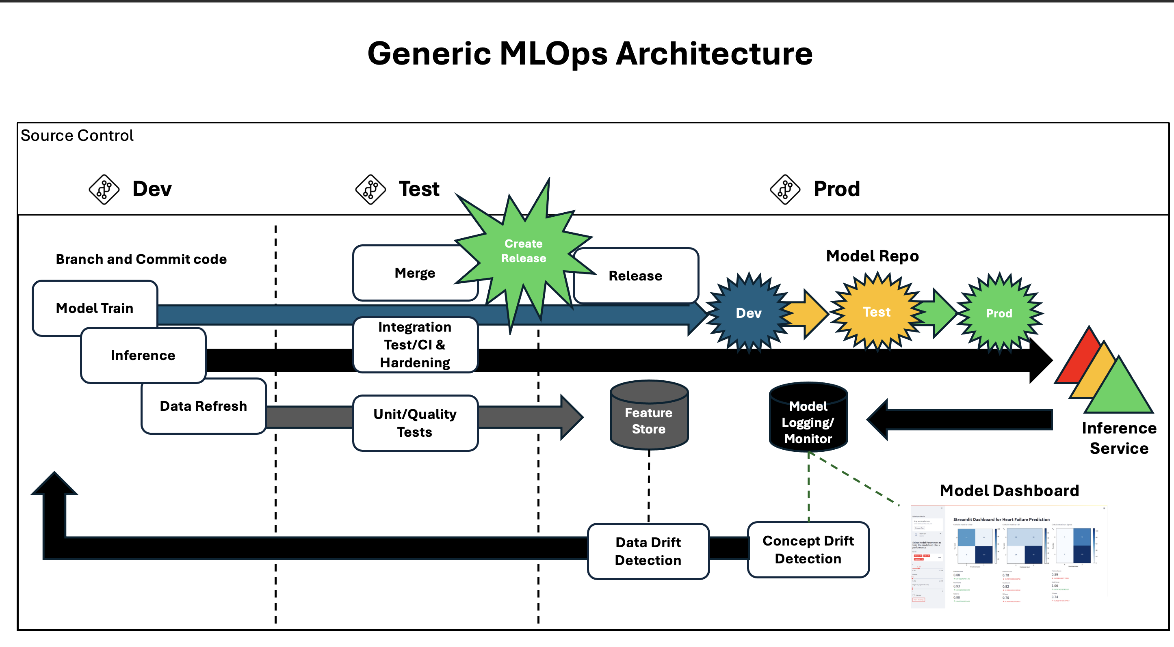
MLOps Arch

